Slide 1

Hi-Fi Prototype V2

Slide 2
memreprise

Slide 3

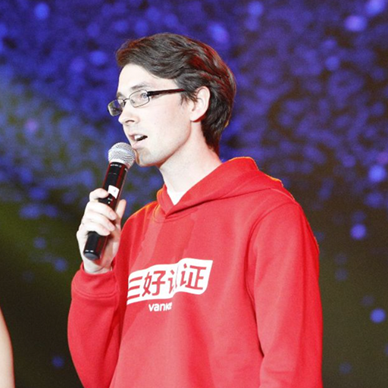
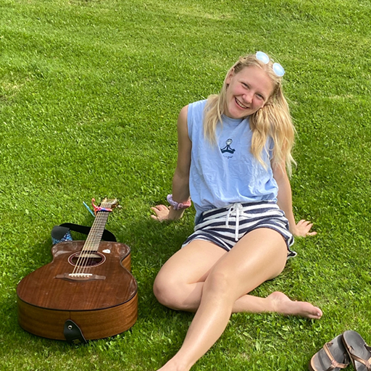
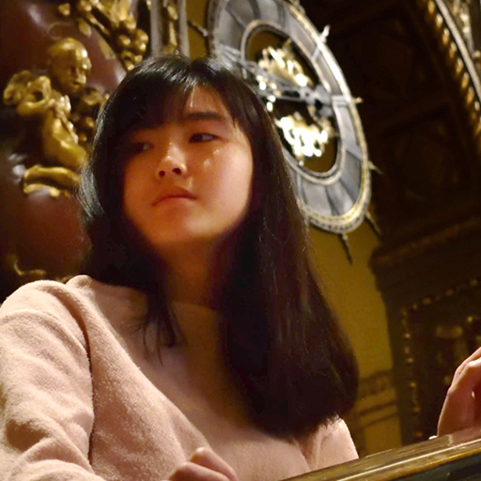
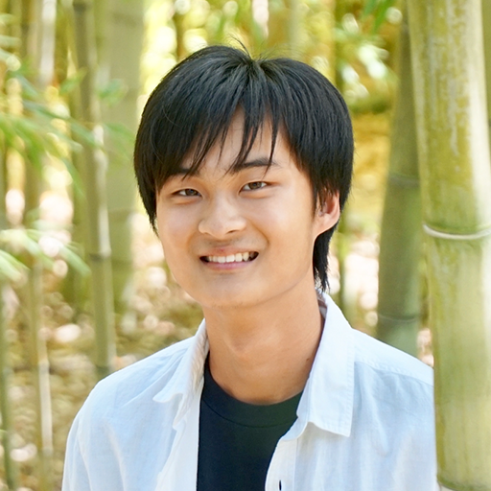
Our Team
Casey N.
Developer
Brent J.
Designer Developer PM
Emily R.
Designer Developer PM
Gray W.
Designer Developer
Tristan W.
Designer Developer

Slide 4
Outline
01
App Overview
02
Interface Changes
03
Task Flows
04
Future Work

Slide 5
01
Introduction

Slide 6
Problem
Music is inherently social.
Music streaming platforms today offer access to diverse music, but lack engaging social features.
We want to help people foster relationships through music.

Slide 7


Solution
We want to make sharing music engaging.
Users can leave music boxes at places as gifts for friends.
Users can explore what their community is listening to geographically.

Slide 8
Value Proposition
We offer a social music-sharing mobile app where users can:
Gift songs,
Receive songs as gifts by surprise or in real-time, and
Tune in to the music of community members nearby and around the world.
The app is location and community-based.
This enables meaningful interaction and the discovery of new music in a fun, community-oriented way.

Slide 9
02
UX/UI Changes

Slide 10

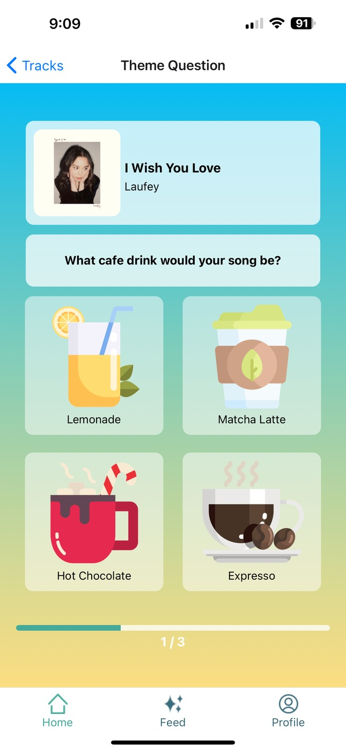


Previous Mood & Theme
Previous
Evoke calmness & reflection
#ffd966
#fce08c
#fff3ce
#1c2e50
#9ecaec
#44aa99

Slide 11
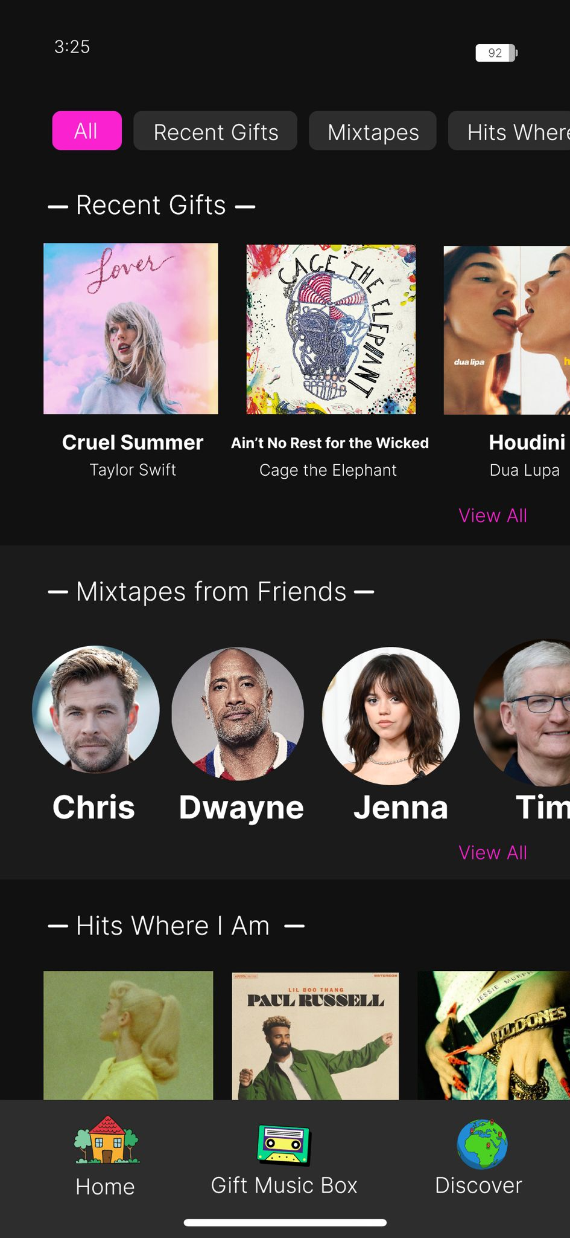
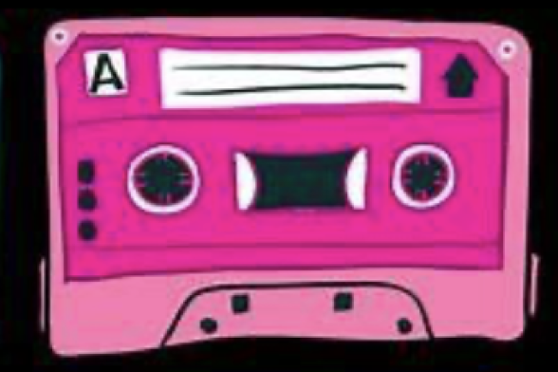
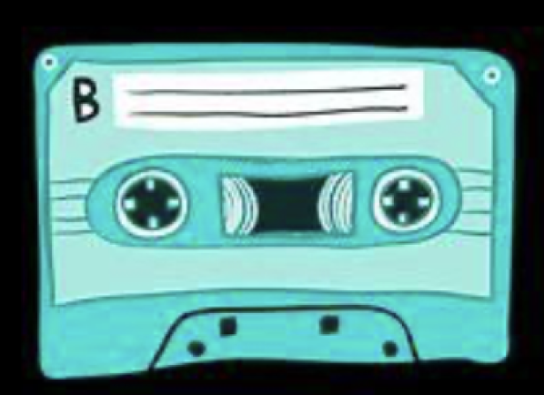
Updated Mood & Theme
Update
Encourage fun, energy, & connection
#F53DAF
#a0f5f2ff
#C9C9C9
#2D2D2D
#050402

Slide 12
Feature Redirection
Previous
Update
Rationale
Post songs publicly with pre-defined prompts
Share songs tied to locations to friends and family
Pre-defined prompts felt forced
Create playlists based on themes
Discover songs and explore playlists through personal gifts and community locations
Music fosters relationships – this is our advantage
Internal reflection and journaling centered on songs
Focus on shared memories through music
Foster social connection while maintaining nostalgia
1
2
3

Slide 13
Lab Study Lessons
User Lab Lesson
Update
Rationale
Low app satisfaction, and confusing and un-engaging onboarding
Re-center app on social features and re-design to emphasize fewer, more direct actions
Lack of onboarding engagement signified a larger problem of lack of resonance with app features. We want to foster social connection while maintaining nostalgia
Un-aligned mental models on how to organize song memories
Tie songs to geographic location as a natural way to link songs to memories
Make song reflections more aligned with people's’ lived experiences, not a stilted reflection model
1
2

Slide 14
03
Task Flows

Slide 15
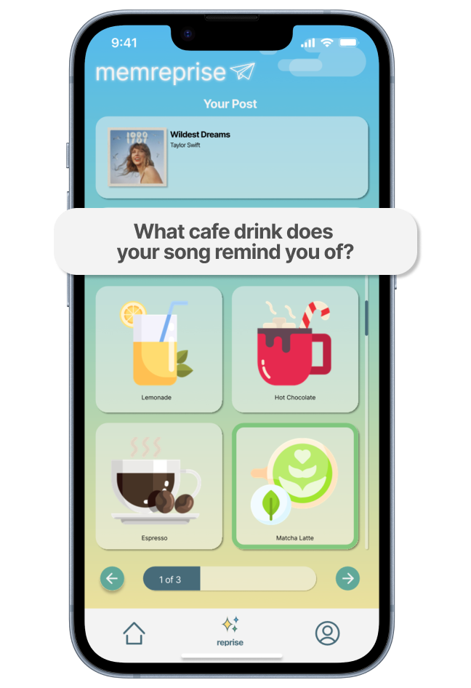
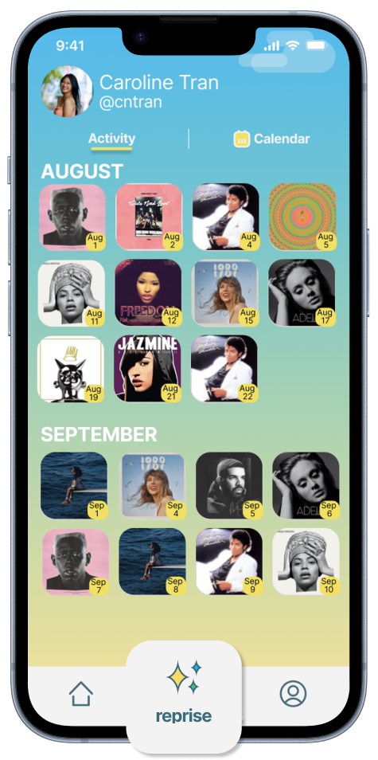
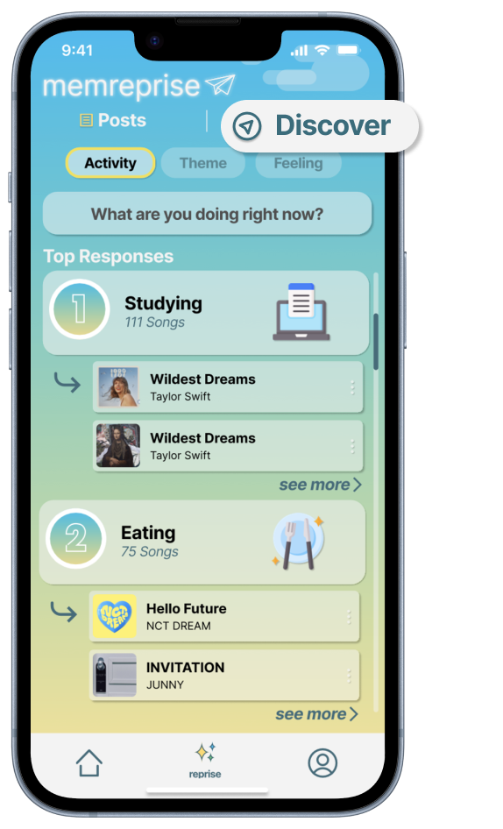
Tasks: V1
Task 1: Reflect on a song
Task 2: Revisit song reflections
Task 3: Discover friends’ reflections

Slide 16
Tasks: V2
Task 1
Send a ‘musicbox’ to a friend
Task 2
Interact with a ‘mixtape’ from a friend
Task 3
Discover music from a community location

Slide 17
Task 1
Send a ‘musicbox’ to a friend

Slide 18
Task 1
Item:
Musicbox
Description:
Receive and send songs as gifts to friends and families with a personalized touch.
Value:
Share and save cherished musical memories with friends and family.
Note: Features organized to simulate scroll / user journey

Slide 19
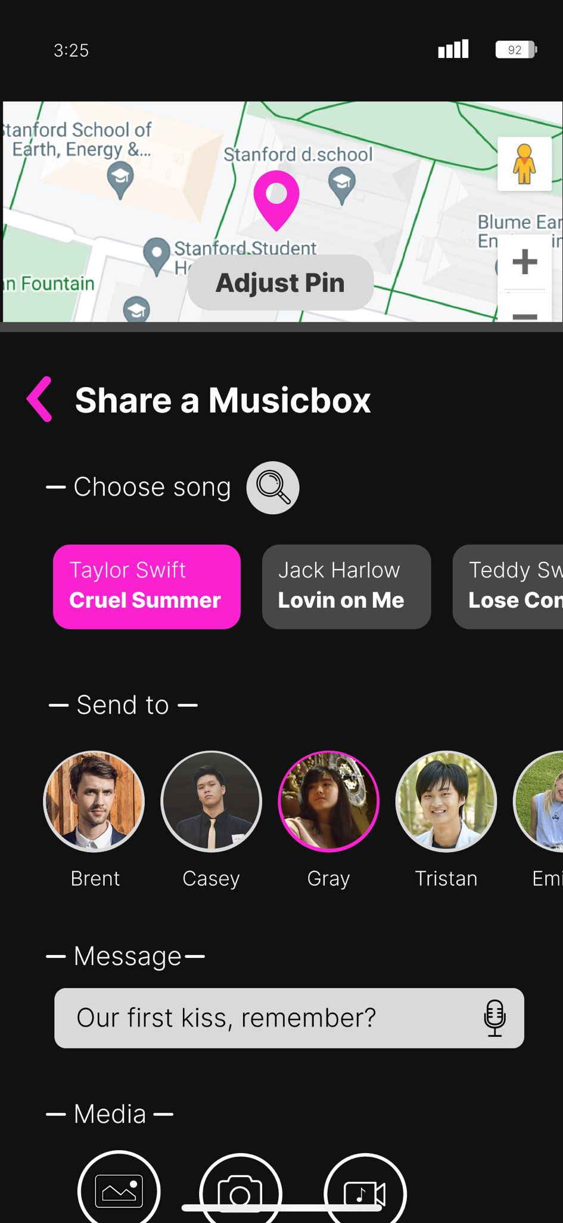
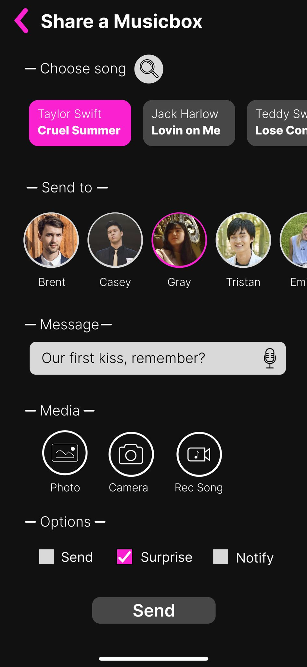
Task 1
Item:
Musicbox
Description:
Receive and send songs as gifts to friends and families with a personalized touch.
Value:
Share and save cherished musical memories with friends and family.

Slide 20
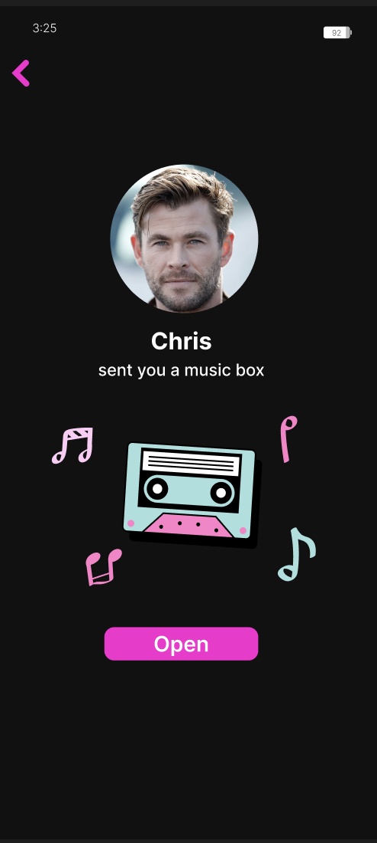
Task 1
Item:
Musicbox
Description:
Receive and send songs as gifts to friends and families with a personalized touch.
Value:
Share and save cherished musical memories with friends and family.

Slide 21
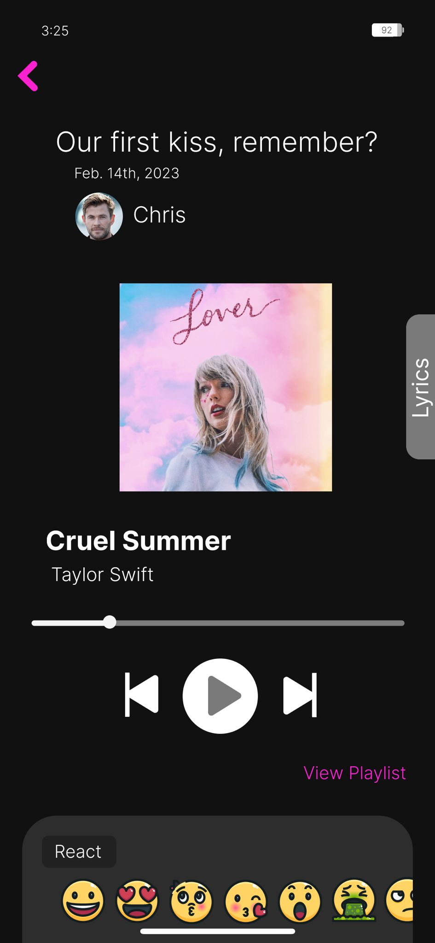
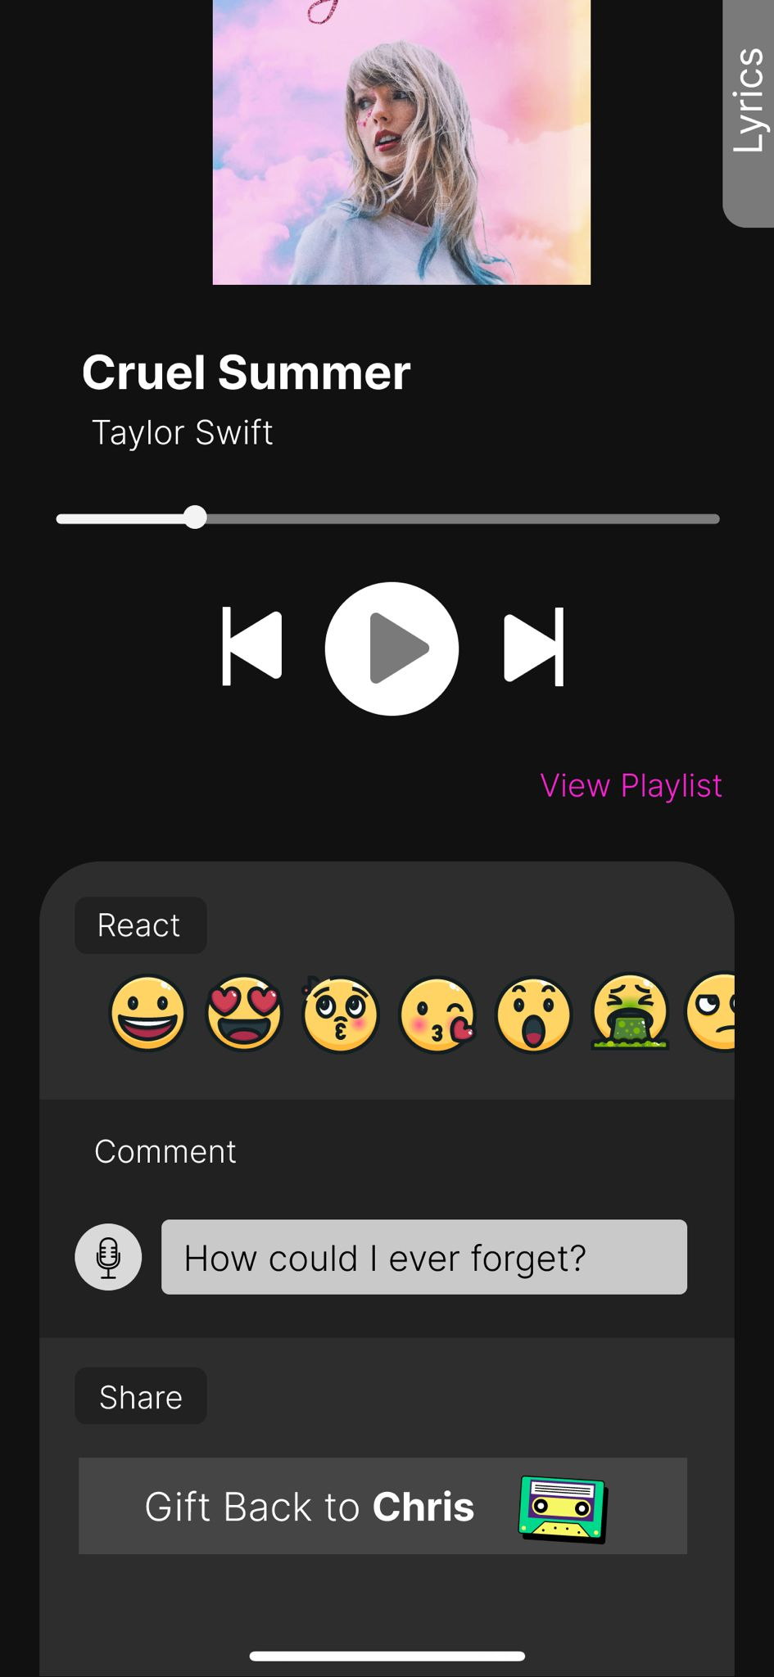
Task 1
Item:
Musicbox
Description:
Receive and send songs as gifts to friends and families with a personalized touch.
Value:
Share and save cherished musical memories with friends and family.

Slide 22
Task 1
Item:
Musicbox
Description:
Receive and send songs as gifts to friends and families with a personalized touch.
Value:
Share and save cherished musical memories with friends and family.

Slide 23
Task 2
Interact with a ‘mixtape’ from a friend

Slide 24
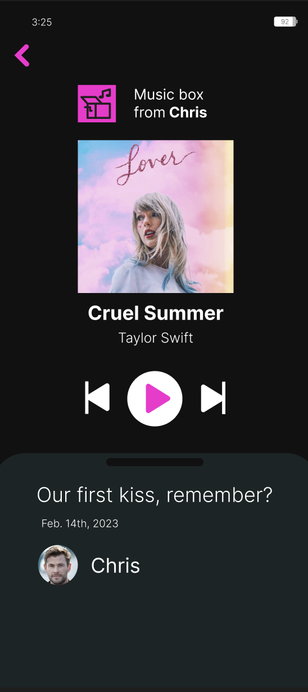
Music Boxes
Item:
Music Boxes
Description:
Receive and send songs as gifts to friends and families with a personalized touch.
Value:
Share and save cherished musical memories with friends and family.

Slide 25

Task 2
Item:
Mixtapes
Description:
Listen to mixtapes, aka playlists, of songs arranged by who sent them to you.
Value:
Share and save cherished musical memories with friends and family.

Slide 26
Task 2
Item:
Mixtapes
Description:
Listen to mixtapes, aka playlists, of songs arranged by who sent them to you.
Value:
Share and save cherished musical memories with friends and family.

Slide 27
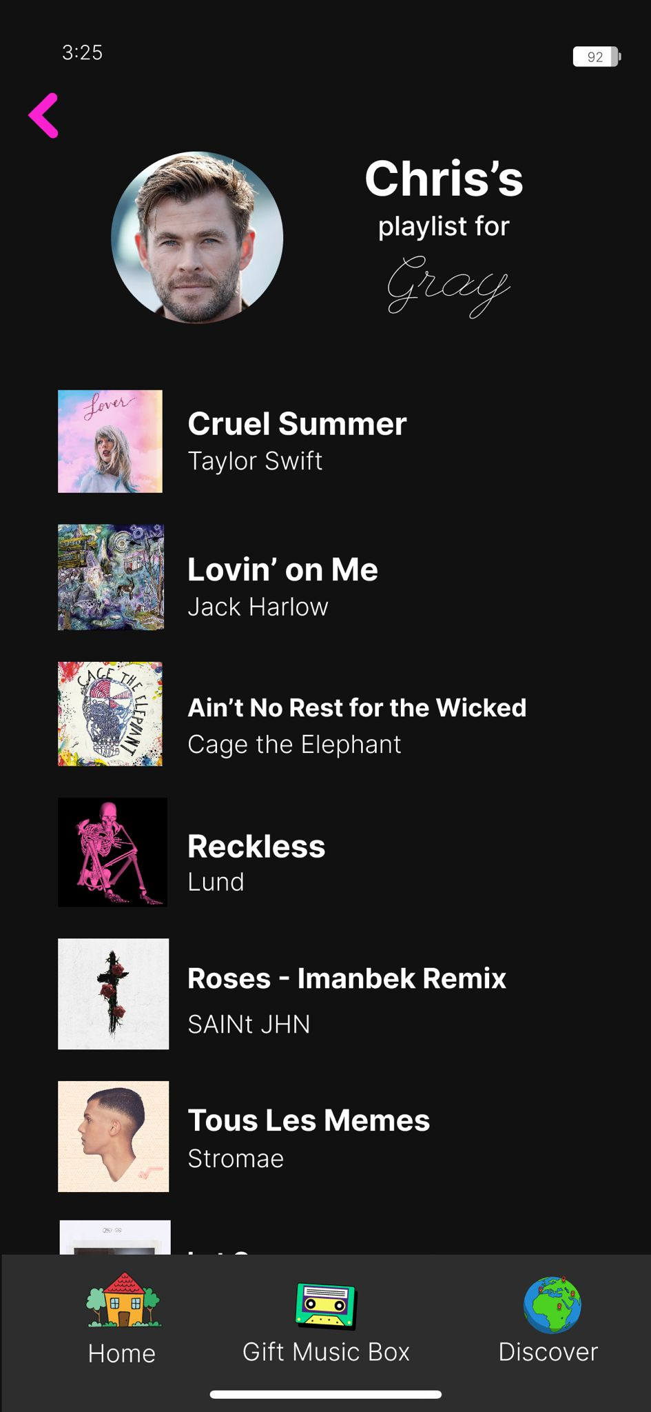
Task 2
Item:
Mixtapes
Description:
Listen to mixtapes, aka playlists, of songs arranged by who sent them to you.
Value:
Share and save cherished musical memories with friends and family.

Slide 28
Task 2
Item:
Mixtapes
Description:
Listen to mixtapes, aka playlists, of songs arranged by who sent them to you.
Value:
Share and save cherished musical memories with friends and family.

Slide 29
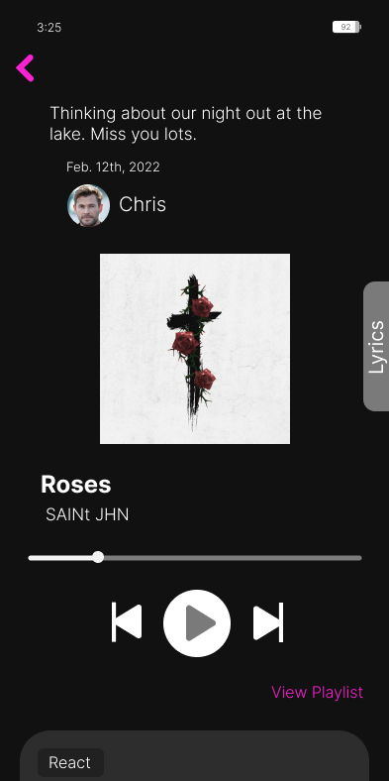
Task 2
Item:
Mixtapes
Description:
Listen to mixtapes, aka playlists, of songs arranged by who sent them to you.
Value:
Share and save cherished musical memories with friends and family.

Slide 30
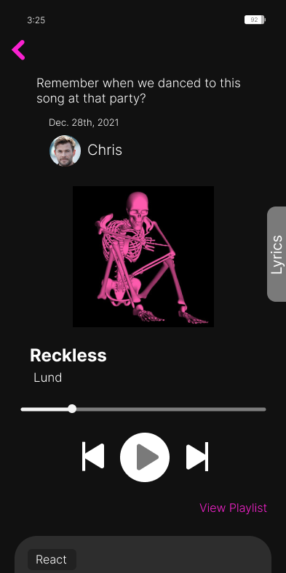
Task 2
Item:
Mixtapes
Description:
Listen to mixtapes, aka playlists, of songs arranged by who sent them to you.
Value:
Share and save cherished musical memories with friends and family.

Slide 31
Task 3
Discover music from a community location

Slide 32
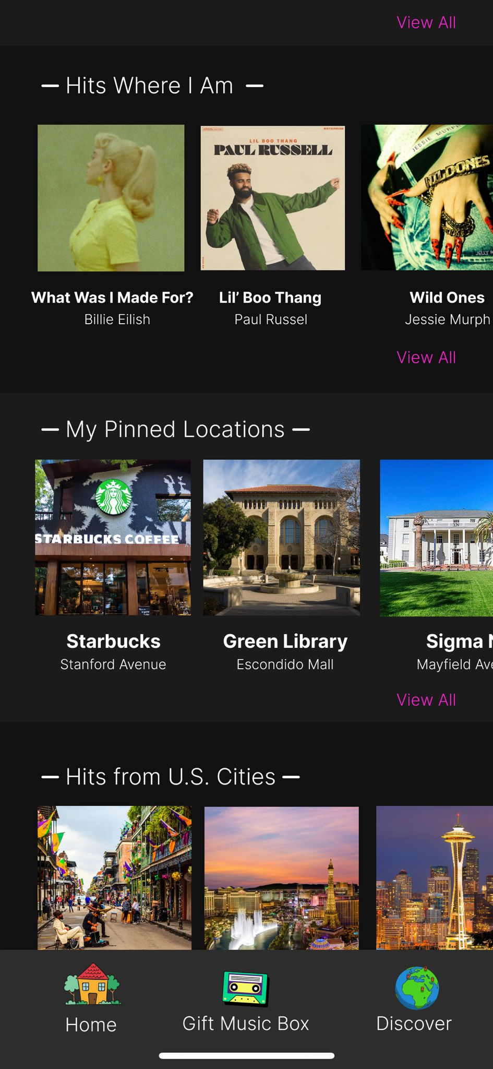
Task 3
Item:
Community Locations
Description:
Discover music in unique ways by getting auto-generated playlists of music played near you, in cities around the world, and locations you pin.
Value:
Get introduced to new music and expand your musical palette.

Slide 33
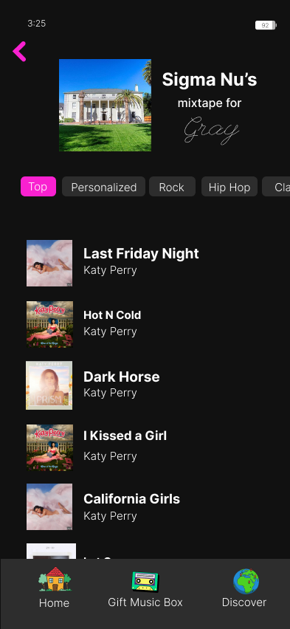
Task 3
Item:
Community Locations
Description:
Discover music in unique ways by getting auto-generated playlists of music played near you, in cities around the world, and locations you pin.
Value:
Get introduced to new music and expand your musical palette.

Slide 34
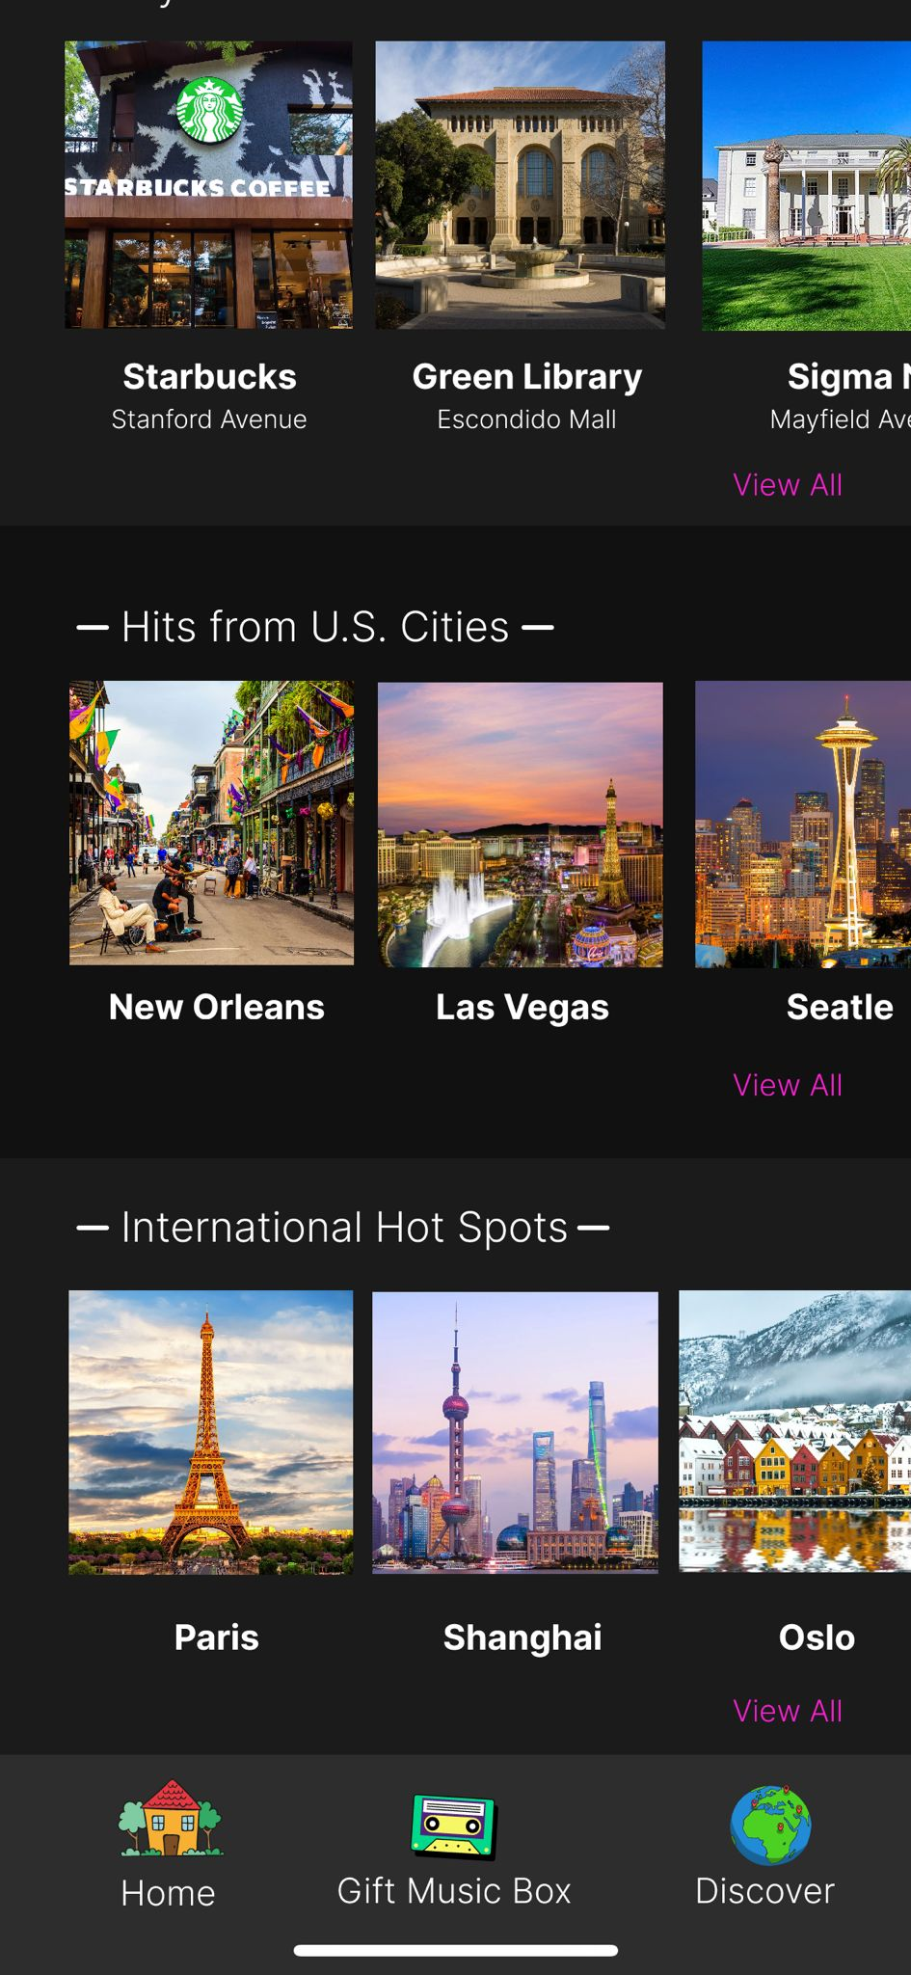
Task 3
Item:
Community Locations
Description:
Discover music in unique ways by getting auto-generated playlists of music played near you, in cities around the world, and locations you pin.
Value:
Get introduced to new music and expand your musical palette.

Slide 35
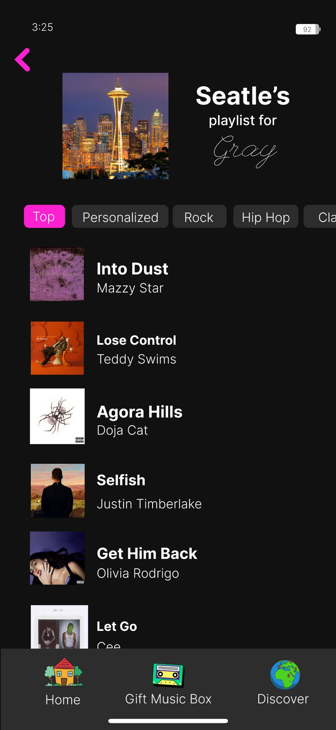
Task 3
Item:
Community Locations
Description:
Discover music in unique ways by getting auto-generated playlists of music played near you, in cities around the world, and locations you pin.
Value:
Get introduced to new music and expand your musical palette.

Slide 36
04
Future Work

Slide 37
What’s Missing & Next Steps
Location Database
Connect location pins to backend database
Message Interface
Allow users to message each other and send “mixtapes”
Live Location
Track user’s live location (with permission) to notify them when they’re within a music box’s range
Notifications
Implement in-app and push notifications
Play songs
Play song snippets within app with option to open streaming app
Attach media
Attach photo to a “music box” location pin
Upload Audio
Allow users to record audio for voice messages and song covers
Profile Exploration
Create profile page and allow users to be able to click anyone’s profile on any page
Notes:
Please mention that these are features that are left out!

Slide 38
Wizard of Oz Techniques
Static elements
Recent Gifts
Mixtapes from Friends
Hits Where I Am
Hits from U.S. Cities
International Hot Spots
Location Pins
Can create location pins, name them, and add descriptions but currently not connected to database
Prototype
Playlists of music boxes near me
Location names

Slide 39
Adapting for Field Tests
Privacy and Data Security:
Implement privacy controls and data protection, especially for features that track or share users' locations.
Inform users about how their data will be used
Scalability and Performance:
Monitor the app’s performance as more users join and interact simultaneously, especially for features that rely on real-time updates or location data.

Slide 40
thanks
any questions?

Slide 41
05
Appendix

Slide 42
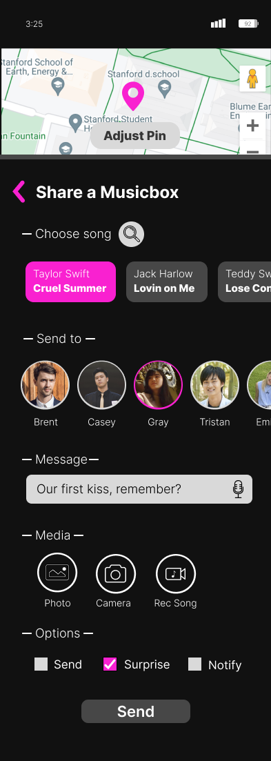
Repo + README
GitHub link
README

Slide 43

Previous Task 1, in hi-fi
POST A SONG ONTO YOUR FEED

Slide 44
Previous Task 2, in hi-fi
DISCOVERING MUSIC POSTED BY OTHER USERS AROUND YOU

Slide 45
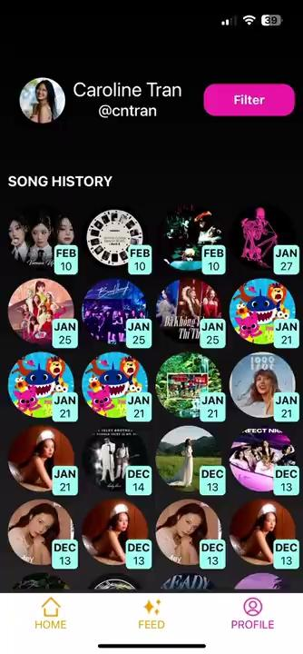
Revised Task 3, in hi-fi
REPRISE CHANGED TO FILTERING THROUGH POSTS

